Slide 1




What is new in C# 6.0 and 7.0
How does C# evolve as a language?
C#
Nikolay Kostov
http://nikolay.it
Software University
https://softuni.bg

Slide 2
About me
Nikolay Kostov
13 years of development experience (20 with overtime ☺)
Microsoft Certified Trainer with more than 15 exams taken
Worked in Telerik as a Manager, Software Engineering and as a part of the Telerik Academy with more than 400 videos in YouTube
Currently working at ZenCodeo as a Solutions Architect
How to find me:
Blog: http://nikolay.it/
GitHub: https://github.com/NikolayIT
Facebook: https://www.facebook.com/Nikolay.IT

Slide 3

Table of Contents
History of the C# Language
What's new in C# 6.0 (2015)?
Roslyn, String Interpolation, Exception Filters, ?.
nameof, Expression Bodies, using static, etc.
What's new in C# 7.0 (2017)?
Literals, Local Functions, Tuples, Deconstruction
Ref Returns and Locals, out Variables, Pattern Matching, throw
Plans for C# 7.1 ☺

Slide 4
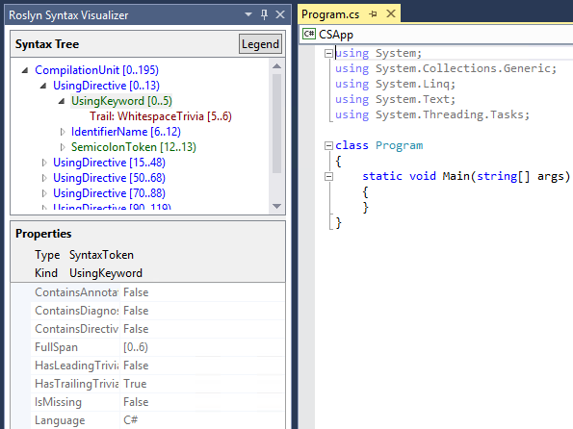
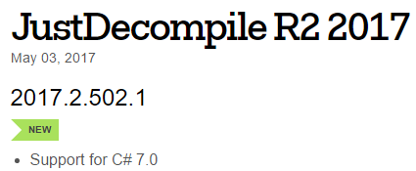
Used Software and Tools
Visual Studio 2017
.NET Compiler Platform SDK: link
Documentation and Roslyn source code
https://github.com/dotnet/roslyn
Demo code available in GitHub:
https://github.com/NikolayIT/CSharp-New-Features
ILSpy for decompiling the C# 6.0 code
http://ilspy.net/
JustDecompile for decompiling C# 7.0 code
http://www.telerik.com/products/decompiler.aspx

Slide 5
History of the C# Language
VS 2002 .NET 1.0
https://github.com/dotnet/csharplang/blob/master/Language-Version-History.md
C# 1.0
Managed Code
C# 2.0
VS 2005 .NET 2.0
Generics <T>
Reflection
Anonymous Methods
Partial Types
Nullable Types
C# 3.0
VS 2008 .NET 3.5
Lambda Expression
LINQ
Anonymous Types
Extension Methods
Implicit Type (var)
C# 4.0
VS 2010 .NET 4.0
dynamic
Named Arguments
Optional Parameters
More COM Support
C# 5.0
VS 2012 .NET 4.5
Async / Await
Caller Information
C# 6.0
VS 2015
.NET 4.6
.NET Compiler Platform (Roslyn)
A lot of new features – mainly syntactic sugar
C# 7.0
VS 2017 .NET 4.7
A lot of new features
C# 7.1
VS 2017 Update 3
10 planned features

Slide 6

C# 6.0
Roslyn – The .NET Compiler Platform
Auto-property Enhancements
Expression Bodied Function Members
Using Static
nameof Operator
String Interpolation
Exception Filters
Null-conditional Operators (?.)
Dictionary Initializer
Await in catch/finally Blocks

Slide 7
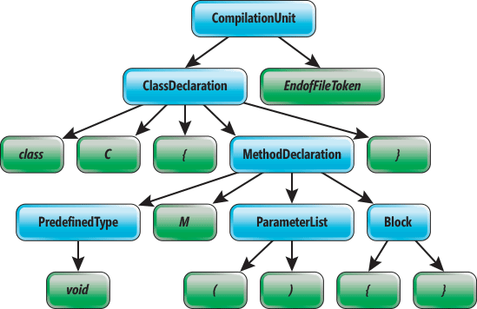
Roslyn
The .NET Compiler Platform

Slide 8
Roslyn – The .NET Compiler Platform
The compiler has been a black box before C# 6.0
Microsoft decided to re-write the compiler
Compiler for C# written in C#, compiler for VB.NET – in VB.NET
Open source: https://github.com/dotnet/roslyn
Easier to extend and maintain
Roslyn exposes modules (API) for syntactic (lexical) analysis of code, semantic analysis, dynamic compilation to CIL and more
Example for "Prefix local calls with 'this'": rule – link, fix – link
Video with more details (in Bulgarian): youtu.be/EXB5Izkkf44

Slide 9

Auto-property Enhancements

Slide 10
Auto Property Initializers
You can add an initializer to an auto-property, just as you can to a field:
The constructor directly initializes the backing field
Just like field initializers, auto-property initializers cannot reference "this"
public class Person
{
public string FirstName { get; set; } = "Nikolay";
public string LastName { get; set; } = "Kostov";
}
this.<FirstName>k__BackingField = "Nikolay";

Slide 11
Default Values for Getter-only Properties
Auto-properties can now be declared without a setter:
The backing field of a getter-only auto-properties is implicitly declared as read-only and is initialized in the constructor:
It can be assigned to via property initializer
In future releases it will be possible to assign it in the declaring type's constructor body
public string FirstName { get; } = "Nikolay";
.field private initonly string '<FirstName>k__BackingField'

Slide 12

Expression Bodied Function Members
Lambda expressions can be declared with an expression body as well as a conventional function body consisting of a block

Slide 13
Expression as Method Body
Methods as well as user-defined operators and conversions can be given an expression body by use of the “lambda arrow”:
The effect is exactly the same as if the methods had had a block body with a single return statement
For void returning methods - expression following the arrow must be a statement
public object Clone() => new Point(this.X, this.Y);
public static Complex operator +(Complex a, Complex b) => a.Add(b);

Slide 14
Expression as Property Getter
Expression bodies can be used for writing getter-only properties and indexers where the body of the getter is given by the expression body
Note that there is no get keyword
It is implied by the use of the expression body syntax
public string Name => FirstName + " " + LastName;
public Person this[string name] =>
this.Children.FirstOrDefault(x => x.Name.Contains(name));

Slide 15

Using Static

Slide 16
Import of Static Type Members into Namespace
Allows specifying a static class in a using clause
All its accessible static members become available without qualification
using static System.Console;
using static System.Math;
class Program
{
static void Main()
{
WriteLine(Pow(2, 10));
}
}

Slide 17

nameof Operator

Slide 18
nameof() Operator
Occasionally you need to provide a string that names some program element
When throwing ArgumentNullException
When raising a PropertyChanged event in WPF
When selecting controller name or redirecting to action in MVC
nameof operator gives us compiler checks, easy navigation and is easy for renaming (refactoring)
if (x == null) throw new ArgumentNullException(nameof(x));
@Html.ActionLink("Sign up", nameof(UserController), "SignUp")

Slide 19

String Interpolation

Slide 20
String Interpolation
Template string that contains interpolated expressions and inserts values into a string with simple syntax
Replaced with string.Format() during compile-time
Can contains variables, simple and complex expressions, array accesses, method calls, etc.
Console.WriteLine($"Name = {name}, hours = {hours:hh}");
Console.WriteLine(string.Format("Name = {0}, hours = {1:hh}", name, hours));
Console.WriteLine($"{cores} core{(cores == 1 ? null : "s")}");

Slide 21

Exception Filters

Slide 22
Exception Filters
If the parenthesized expression evaluates to true, the catch block is run. Can be used to call a method before catch.
Implemented with a "filter" block in CIL
try {
person = new Person("Nikolay", null);
}
catch(ArgumentNullException e) when (e.ParamName == "firstName") {
Console.WriteLine("First name is null");
}
catch(ArgumentNullException e) when (e.ParamName == "lastName") {
Console.WriteLine("Last name is null");
}

Slide 23
Logging with Exception Filters
We can use exception filters for side effects (e.g. logging)
Exception filters are preferable to catching and rethrowing (they leave the stack unharmed)
You have access to the actual stack when the exception arises
try { ... }
catch (Exception ex) when (Log(ex)) { ... }
private static bool Log(Exception exception)
{
Console.WriteLine(exception.Message);
return false;
}

Slide 24
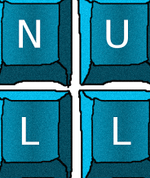
Null-conditional Operators
Null-propagating operator ?.

Slide 25
Null-conditional Operator
Lets you access members and elements only when the receiver is not-null
Providing a null result otherwise
Can be used together with the null coalescing operator ??:
Can also be chained
int? length = customers?.Length; // null if customers is null
Customer first = customers?[0]; // null if customers is null
int length = customers?.Length ?? 0; // 0 if customers is null
int? first = customers?[0].Orders?.Count();

Slide 26

Dictionary Initializer

Slide 27
Dictionary Initializer
A new syntax to object initializers allowing to set values to keys through the indexers
Before (C# 5.0)
Now (C# 6.0+)
var numbers = new Dictionary<int, string> {
{ 7, "seven" },
{ 13, "thirteen" }
};
var numbers = new Dictionary<int, string> { [7] = "seven", [13] = "thirteen" };

Slide 28

Await in catch/finally Blocks

Slide 29
Await in catch/finally Blocks
In C# 6.0 await is now allowed in catch and finally blocks
Implemented with IAsyncStateMachine and all logic is in the MoveNext method which uses TaskAwaiter to wait the threads
var input = new StreamReader(fileName);
var log = new StreamWriter(logFileName);
try {
var line = await input.ReadLineAsync();
}
catch (IOException ex) {
await log.WriteLineAsync(ex.ToString());
}
finally {
await log.FlushAsync();
}

Slide 30
C# 7.0
More Expression-bodied Members
Number Literals Improvements
Local Functions
ref Returns and Locals
Out Variables
Pattern Matching
Throw Expressions
Tuples
Deconstruction

Slide 31
More Expression-bodied Members

Slide 32
More Expression-bodied Members
C# 7.0 adds expression-bodies support for constructors, destructors, property accessors (get, set) and event accessors
public Resource() => Console.WriteLine($"Constructing...");
~Resource() => Console.WriteLine("Destructing...");
public int X
{
get => this.x;
set => this.x = value;
}
public event EventHandler ToStringCalledEvent
{
add => this.toStringCalledEventHandler += value;
remove => this.toStringCalledEventHandler -= value;
}

Slide 33
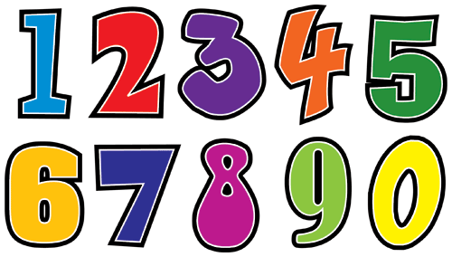
Number Literals Improvements
Binary Literals and Digit Separators

Slide 34
Number Literals Improvements
Using the 0b prefix, a binary literal can be defined (just like the hexadecimal literals with 0x)
In C# 7.0 any sequence of digits may be separated by underscores, possibly more than one _ between two digits
byte n = 0b01001110; // 78 in decimal
int bin = 0b1001_1010_0001_0100;
int hex = 0x1b_a0_44_fe;
int dec = 33_554_432;
int weird = 1_2__3___4____5_____6______7_______8________9;
double real = 1_000.111_1e-1_000;

Slide 35

Local Functions

Slide 36
Local Functions
Options before C# 7.0
Private methods – accessible for every class member, no closure
Func and Action – allocations, no generic, no out/ref, no params
C# 7.0 adds support for local functions – can be defined in the body of any method, constructor or property’s getter, and setter
Can be generic, async, dynamic with access to closure
Will be transformed by compiler to regular private static method
Useful when creating method wrappers (e.g. for validation)

Slide 37

ref Returns and Locals
Using ref keyword for return result and local variables

Slide 38
ref Returns and Locals
Local variables can now be declared with the ref modifier
The ref keyword can also be used with the return type
Already available in IL code but was not reflected in C#
var newValue = oldVar; // newValue is now poining to oldVar's data
ref var newVar = ref oldVar; // newVar is pointing to oldVar
newVar
oldVar
oldVar's data
newValue
static ref int GetByIndex(int[] arr, int ix) => ref arr[ix];

Slide 39
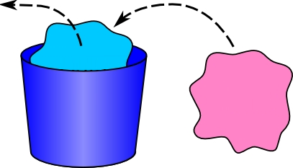
Out Variables

Slide 40
Out Variables
Before C# 7.0 we can call a method with out parameters only if we declare variables before passing them to the method
Now we can merge declaration and passing the variable
The compiler can usually tell what variable's type should be
int x;
int.TryParse("123", out x);
int.TryParse("123", out int x); // Define and assign x
int.TryParse("123", out var x); // Infer the type of x
int.TryParse("123", out _); // Discard the result
_ = 42; // In C# 7.0 _ can be used to discard an expression result

Slide 41

Pattern Matching
Syntactic elements that can test that a value has a certain "shape"

Slide 42
Pattern Matching
Patterns are a new kind of language element in C# which test if a value has a certain "shape" and extract information from it
C# 7.0 is enhancing two existing constructs with patterns "is" expressions and switch statements (more to come)
Is-expressions with patterns
if (o is null) return; // constant pattern "null"
if (!(o is int i)) return; // type pattern "int i"
// We can use variable i (of type int) here
if (o is int _) return; // discarding variable and just check the type
if (o is int i || (o is string s && int.TryParse(s, out i)) { /* use i */ }

Slide 43
Pattern Matching (2)
Switch statements are reworked and now we can use patterns in case clauses, to switch on any type (not just primitive types) and have additional conditions on them
The order of case clauses now matters (first match gets picked)
The default clause is always evaluated last
switch(shape) {
case Circle c: break; // circle
case Rectangle s when (s.Length == s.Height): break; // square
case Rectangle _: break; // rectangle discarding the variable
case null: throw new ArgumentNullException(nameof(shape));
}

Slide 44

Throw Expressions
Throw an exception in the middle of an expression

Slide 45
Throw Expressions
C# 7.0 fixes some of the limitations when throwing exceptions:
Throw as the second condition in the null-coalescing operator
Throw exceptions in the expression-bodied member
Throw in the conditional operator ( ?: ) as well
var firstName = name ?? throw new ArgumentNullException();
public string DoMagic() => throw new NotImplementedException();
var arrayFirstValue = (array.Length > 0) ? array[0] :
throw new Exception($"{nameof(array)} contains no elements.");

Slide 46

Tuples
Return more than one value from a method

Slide 47
Tuples
Return multiple values before C# 7.0: out parameters, Tuple<> instance, custom type or anonymous type as dynamic result
C# 7.0 adds support for tuples (requires System.ValueTuple)
Can also be used in variables
public static (string title, string description) GetInfo(int id)
=> ("CLR", "Common Language Runtime")
var info = GetInfo(1337);
Console.WriteLine($"{info.title} {info.description}");
(string title, string description) = GetInfo(1337);
(string title, string description) data = ("Title", "Description");
(int, string str, object) varTuple = (42, "String", new object());

Slide 48

Deconstruction

Slide 49
Deconstruction
In C# 7.0 any type can be converted to tuple (deconstructed) using the deconstructor method with name "Deconstruct"
Extension methods can also be used to attach deconstructor
Every type with deconstruct method can be assigned to a tuple:
public void Deconstruct(out string firstName, out string lastName) {
firstName = this.FirstName;
lastName = this.LastName;
}
public static void Deconstruct(
this DateTime dateTime, out int year, out int month, out int day)
(int year, int month, int day) = DateTime.Now;

Slide 50

Plans for C# 7.1
Noting is official, nothing is implemented, yet

Slide 51

Plans for C# 7.1
List of all: https://github.com/dotnet/csharplang/milestone/5
Async Main
"default" literal
Nullable-Enhanced Common Type
static async Task Main(string[] args) =>
Console.WriteLine(await new HttpClient().GetStringAsync(args[0]));
int x = default; // Instead of default(int) or 0
return default;
var x = flag ? default : SomeType.Empty;
void Method(SomeType arrayOpt = default))
int? x = cond ? 42 : null; // Instead of int? x = cond ? 42 : (int?)null;

Slide 52
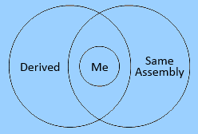
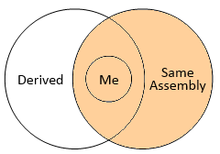
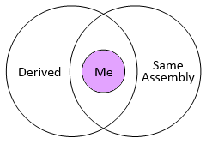
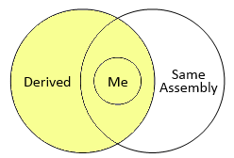
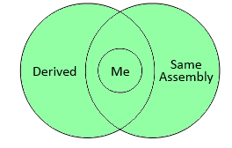
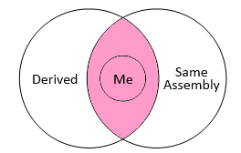
Plans for C# 7.1 (2)
private protected – subclasses contained in the assembly
Discard for lambda parameters (_, _) =>
public
internal
private
protected
protected internal
private protected
dbData.OrderBy(_ => Guid.NewGuid())

Slide 53
Plans for C# 7.1 (3)
Mix Declarations and Variables in Deconstruction
Pattern-matching with generics
Expression variables in initializers
Auto-Implemented Property Field-Targeted Attributes
int x = 0; // Existing variable
(x, var y) = e; // x should be assigned and y declared and assigned
static void M<T>(T o) { if (o is ComplexType x) { } }
static int SisZero => int.TryParse(s, out int i) ? i==0 : false;
public C(string s) : base(int.TryParse(s, out int i) ? i==0 : false)
[field: NonSerialized] // Attribute should goes to the backing field
public string MySecret { get; set; }

Slide 54

Questions?

Slide 55
License
This course (slides, examples, demos, videos, homework, etc.) is licensed under the "Creative Commons Attribution-NonCommercial-ShareAlike 4.0 International" license

Slide 56




Trainings @ Software University (SoftUni)
Software University – High-Quality Education, Profession and Job for Software Developers
softuni.bg
Software University Foundation
softuni.org
Software University @ Facebook
facebook.com/SoftwareUniversity
Software University Forums
forum.softuni.bg

